Slide 1
Survey of Cloud Computing and Azure Foundation
Module 1, Lesson 4:
How to start Azure

Slide 2
Topics
What is a Virtual Machine?
Using Azure to Create and Deploy Virtual Machines
How to use Azure for Data Analysis

Slide 3
Objectives
By the end of this lesson you should be able to:
Explain what a virtual machine is
Use Azure to create a Windows or Linux virtual machine
What is Big Data?
Understand how to use Azure for data analysis

Slide 4
What is a Virtual Machine?
A software implementation of a physical computer
An emulation of a particular computer configuration
An IaaS system that runs an operating system and applications
One of several types of on-demand, scalable computing resources in cloud computing.
Notes:
Notes:
A virtual machine is a software implementation of a computer that executes programs in the same way a physical computer would.
A VM is an operating system or application environment that is installed on software and which imitates dedicated hardware. The user has the same experience on a virtual machine as they would have on dedicated hardware.
The VM is comprised of a set of specification and configuration files and is backed by the physical resources of a host. Users can provision and configure server types, CPU cycles, operating systems, storage capacity, network infrastructure, and security settings through a web-based console.
Examples: Amazon Elastic Compute Cloud (EC2),IBM Bluemix virtual Server, Microsoft Azure VM

Slide 5
Why Virtual Machines?
Easy to stop and start
Disaster recovery
Pay only for what you use
Scalability
Notes:
Notes:
VM startup is relatively quick and easy compared to an installation on physical hardware. VMs allow the user to easily suspend the service and save its state.
Using a VM also allows users to experiment with open-source network simulation tools that run on various operating systems, such as different versions of Linux or Windows, without actually having to install these new systems onto their computers.
Rather than paying continuously for a backup datacenter that's rarely used, disaster recovery in Azure VM provides the ability for users to pay only for the computing resources they need when they really need them.
VM applications allow users to take a “snapshot” of the current configuration of the VM. Unrecoverable problems encountered due to changing or patching software can be easily recovered from by reverting to a previous snapshot of the VM.
Pay only for what you use – Users pay for the resources they need and use but don’t have to continue to invest in many of the products used to support the network and systems, such as spam, anti-virus, encryption, archiving, and so on.
Scalability – In VM, scalability is the capability of a system, network, or process to handle a growing amount of work, or its potential to be enlarged in order to accommodate that growth.

Slide 6
Some Providers for Virtual Machines
Service Provider | Virtual Machine Options
Amazon | Elastic Cloud Compute (Amazon EC2)
Google | Compute Engine
IBM | Bluemix Virtual Servers
Microsoft | Azure Virtual Machine
Notes:
Notes:
Amazon EC2 is a web service that provides resizable computing capacity that is used to build and host software systems.
Google Compute Engine also lets the user choose the machine properties of their instances, such as the number of virtual CPUs and the amount of memory, using a set of predefined machine types or by creating their own custom machine type.
Instances can run Linux and Windows Server images provided by Google, or any customized versions of these images. An instance is a virtual machine hosted on Google’s infrastructure.
IBM Bluemix Virtual Server is designed to support both cloud-native and cloud-enabled workloads, helping companies move faster and scale better across apps and services of all types.
Learn more at:
https://aws.amazon.com/documentation/ec2/?nc1=h_ls
https://cloud.google.com/compute/

Slide 7
Benefits of Azure
Launch websites quickly
Visual Studio development
Ability to use familiar Microsoft tools
Leverage Windows Azure Virtual Machines
Keep data storage simple
Provides big data insights (HDInsight service)

Slide 8
Virtual-Machine Sizes
Azure offers a variety of VM sizes and attributes
Series | Sizes | Attributes
A-Series | A0, A1, A2, A3, A5, A6, A7, A8, A9, A10, A11 | Up to 112 GB RAM and 16 cores Up to 16 Data Disks (1 TB each)
D/DS/Dv2-Series | D1, D2, D3, D4, D11, D12, D14, D5v2 | Up to 100% faster than A-Series Up to 112 GB RAM and 16 Cores Up to 32 data disks (1 TB each) Solid-state drives
G/GS-Series | G1, G2, G3, G4, G5 | 35% faster than D-Series Up to 448 GB RAM and 32 cores Up to 64 data disks (1 TB each) Solid-state drives
Notes:
Notes:
Azure offers a variety of VM sizes in an effort to make sure there’s something to fit everyone’s needs.
Each size is identified by a letter and a number: A0, D1, G2, and so on.
There is documentation online detailing the specs for each machine – number of cores, amount of RAM, type and size of hard disk – as well as the cost.
Not surprisingly, more powerful machines are more.
Prices range from as little as 7 cents an hour for a single core machine running Linux to almost $10 an hour for a machine with 32 cores and almost half a terabyte of RAM.
The G-series machines are reserved for the most power-hungry applications.
References:
https://azure.microsoft.com/en-us/documentation/articles/virtual-machines-linux-sizes/

Slide 9
Power vs. Cost
Three kinds of comparisons in Azure VM sizes
Size | Power | Cost
A8 | 8 Cores 56 GB RAM 32 Gbit/sec InfiniBand with RDMA | Windows: $1.47/hr. or $1,091/mo. Linux: $0.98/hr. or $725/mo.
D1 | 1 Core 3.5 GB RAM 50 GB SSD drives | Windows: $0.14/hr. or $104/mo. Linux: $0.077/hr. or $57/mo.
G5 | 32 Cores 448 GB RAM 6,144 GB SSD drives Latest Xeon E5 v3 processors | Windows: $9.65/hr. or $7,180/mo. Linux: $8.69/hr. or $6,465/mo.
Notes:
Notes:
One thing to keep in mind when deploying VMs is that the organization will be charged for them whether they’re in use or not.
When the company is finished using a VM or a cluster of VMs, they will need to suspend each VM to avoid unnecessary charges.
VMs can also be deleted to avoid incurring storage charges for VMs that are no longer needed.

Slide 10
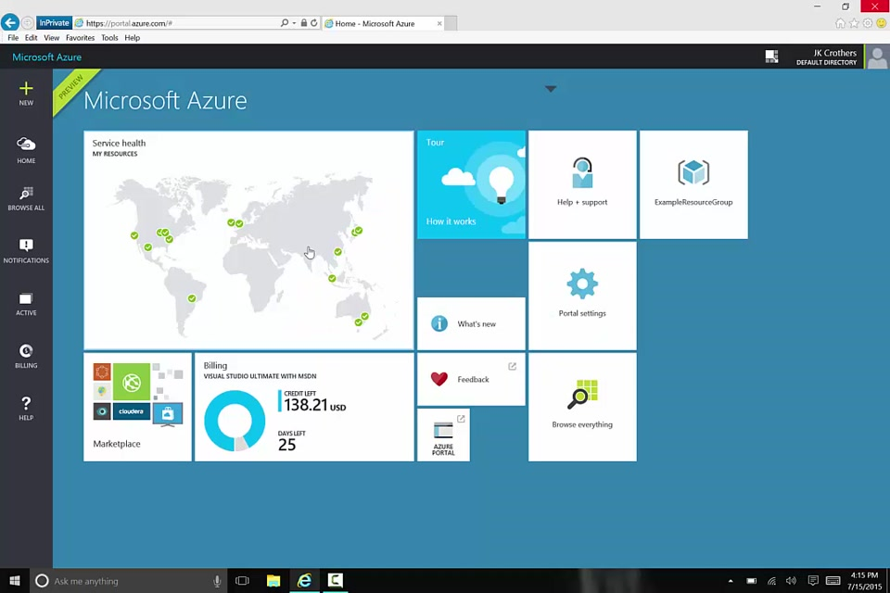
Azure Resource Manager
Resources can be collated into resource groups
Deploy, manage, monitor, and delete all resources at once
Complex deployments can be performed declaratively via deployment templates
Templates specify all the resources — VMs, switches, storage accounts, etc. — to be provisioned
Notes:
Azure Resource Manager enables you to work with the resources in your solution as a group. You can deploy, update or delete all of the resources for your solution in a single, coordinated operation.
References:
Image Source: https://azure.microsoft.com/en-us/documentation/articles/resource-group-overview/

Slide 11
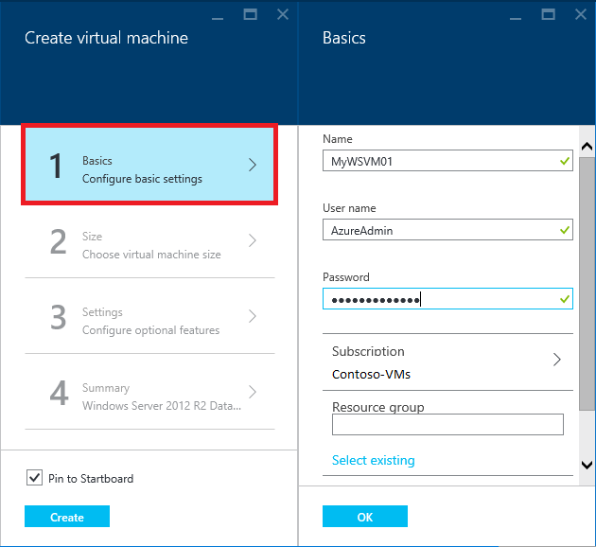
How to create a Windows VM
1. Sign in to the Azure portal
2. On the Hub menu, click New > Virtual Machines > Windows Server 2012 R2 Data center
3. Select a deployment model, select Resource Manager. Click Create.
4. On the Create virtual machine blade section, click Basics, Size, Settings, Summary
5. Enter a value you want for the virtual machine in each phase.
Notes:
Notes:
All new VMs should generally be deployed using the Resource Manager model.
Basics Section:
Name of the VM, username and password that used to login to the VM, a resource group name (or select an existing resource group).
A resource group is automatically created with the current portal. Resource groups provide a way to monitor, control access, provision and manage billing for collection of assets that are required to run an application.
Size Section:
Select an appropriate VM size to suit your needs. You can choose the number of core processors, storage size, number of data disks, and size of SSD memory.
Setting section:
You can configure the storage and networking settings or simply accept the default values.
Summary section:
Review all the settings you have selected so far and click OK if ready to create and deploy.

Slide 12
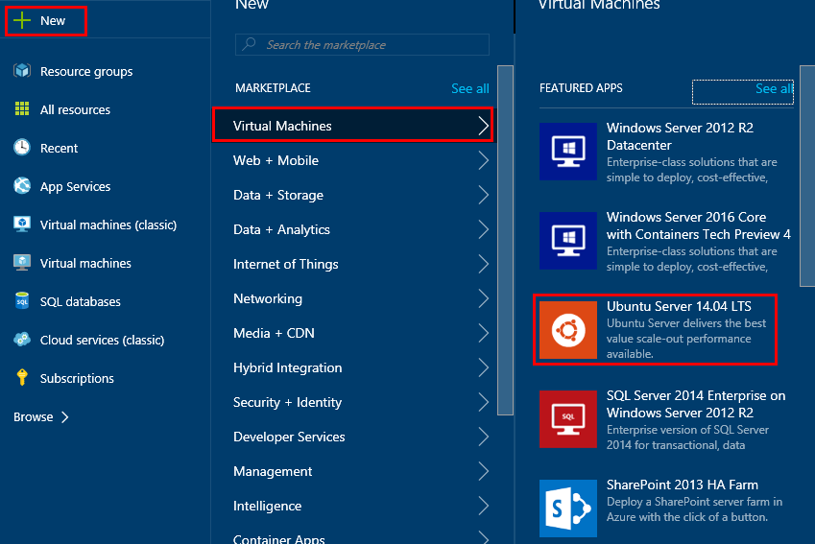
How to create a Linux VM
1. On the Hub menu, click New > Virtual Machines > Ubntu Server 14.04 LTS
2. Select a deployment model, select Resource Manager. Click Create.
3. On the Create virtual machine blade section, click Basics, Size, Settings, Summary .
4. Enter a value you want for the virtual machine in each phase.
Notes:
Notes:
The creation steps are similar to those for the Windows server.

Slide 13
What Is Big Data?
Data
Velocity
The 3 V’s of
Big Data
Real
Time
Computing Today:
Variety
Velocity
Volume
Interval
Sparse
Batch
SMS
XML
RDBMS
Text
KB
Unstructured
Video
CSV
Photos
Data
Variety
MB
GB
EB
TB
ZB
PB
YB
Data
Volume
Notes:
Notes:
Big data refers to data being collected in ever-escalating volumes, at increasingly higher velocities, and in an expanding variety of unstructured formats and variable semantic contexts.
We are generating more data than ever before. The following data sources generate ever-growing amounts of data:
Financial transactions
Sensor networks
Server logs
Analytics
Email and text messages
Social media
Automation, ubiquitous internet connectivity, and user-generated content all allow us to generate data faster than ever before.
For example, every day:
Twitter processes 340 million messages
Amazon S3 storage adds more than one billion objects
Facebook users generate 2.7 billion comments and “likes”
IoT (Internet of Things) will make it worse
The variety of data is unlike anything that has previous been seen.
There are many kinds of data in formats such as:
Structured data
RDBMS
Unstructured data
Videos
Pictures
Patient health records
System log records
XML
PDF
Text
References:
http://blog.sqlauthority.com

Slide 14
The Purpose of Big Data
Motivation for Big Data: changing nature of data
Collecting data from SNS, Blogs, Chats
Data Mining
A tool to help increase sales
What is the Purpose of Big Data?
A way to predict the future
A way to better understand my clients
Notes:
Notes:
Efforts to solve this problem of ever-escalating data resulted in the beginnings of big data:
High performance computing and data warehouses were already processing large structured data sets
Big data datasets, however, are large and often unstructured
Azure’s big data platform is Hadoop Ecosystem
Hadoop is a distributed parallel computing platform based on commodity hardware
Cost effectively scalable to 1000s of nodes
Fault-tolerance built in with the assumption that hardware failure is common
Relatively simple programming paradigm to simplify development of solutions on a distributed parallel computing platform
Includes tools to simplify gathering of data
Provides tools that analysts are already familiar with, including SQL and scripting
Provides business intelligence and visualization tools

Slide 15
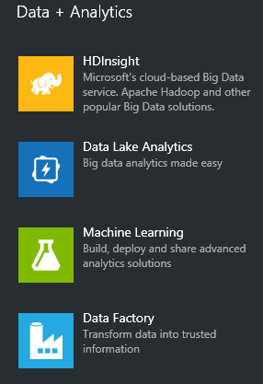
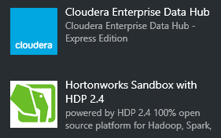
Hadoop Distributions
HDInsight
Cloud-based big data service
Data Lake Analytics, Data Factory
Cloudera enterprise Data Hub
Hortonworks Sandbox with HDP 2.4
Hortonworks Data Platform (HDP)
Notes:
Notes:
There are many tools in Azure for data analytics, but we will focus on HDInsight service here.
Cloudera is an open-source Apache Hadoop distribution. CDH (Cloudera Distribution Including Apache Hadoop) targets enterprise-class deployments of that technology.
Cloudera was founded in 2008 - Doug Cutting, co-creator of Hadoop, joined the company in 2009 as Chief Architect and remains in that role today.
Hortonworks is also an open-source Apache Hadoop distribution company which was formed in June 2011. They offer the Hortonworks Data Platform (HDP).

Slide 16
What is Azure HDInsight & HDP?
HDInsight
Run Apache Hadoop, Spark, HBase and Storm technologies without managing deployment or configuration.
HDP is a Hortonworks specific platform of Hadoop
Crunch all data – structured, semi-structured, unstructured
Develop in several languages including c#, Java, Python and .NET.
Use Excel or your favorite BI tool to visualize data
Use NoSQL transactional capabilities
Provide real-time stream processing
Notes:
Notes:
HDInsight is implemented in Microsoft Azure as the solution for big data. It includes implementations of Apache Spark, HBase, Storm, Pig, Hive, Sqoop, Oozie, Ambari, and others.
This also integrates with business intelligence (BI) tools such as Power BI, Excel, and SQL Server Analysis Services.
Spark – Parallel processing framework that supports in-memory processing
Hbase – NoSQL database that is built on Hadoop
Storm – Processes data in real-time with Hadoop

Slide 17
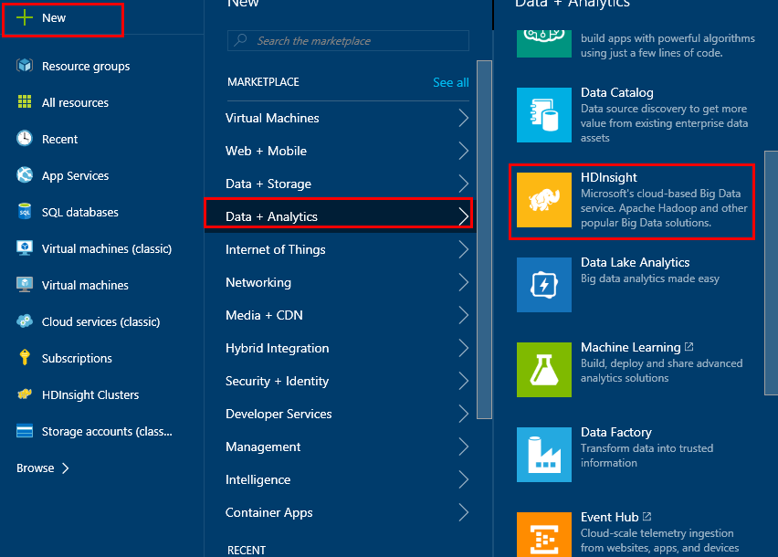
How to Create an HDInsight Instance
1. On the Hub menu, click New > Data + Analytics > HDInsight
3. Select a deployment model, select Resource Manager. Click Create.
4. On the Create virtual machine blade section, click Basics, Size, Settings, Summary .
5. Enter a value you want for the virtual machine in each phase.

Slide 18
Summary
In this lesson, you have learned:
What is Virtual Machine in Azure?
How to use Azure to create both Windows and Linux VM
What is the purpose of Big Data?
Understand how to use Azure for data analysis
Notes:
The Module 1 Lesson 4 Lab should be completed at this time:
https://github.com/MSFTImagine/computerscience/tree/master/Complimentary%20Course%20Content/Module1/Labs

